Slide 1
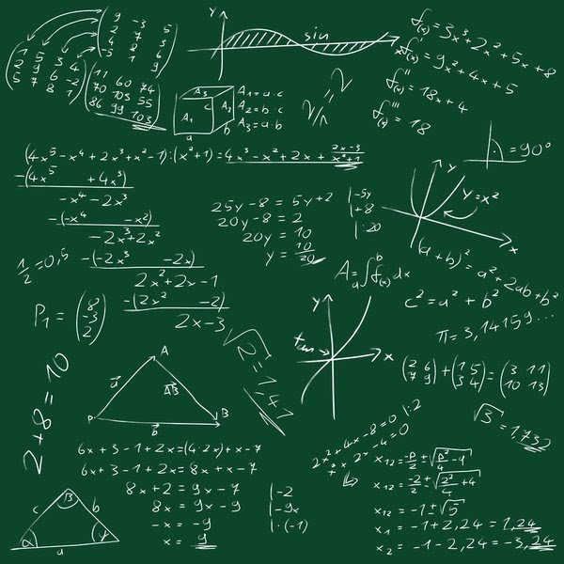
Presentation of Minor Project

Slide 2
MINOR PROJECT
Topic:-Math Quiz Game

Slide 3
Under the Guidance of Assistant Prof. MR Tirubhuwan Tyagi Sir

Slide 4
PROJECT MEMBERS
Ayushi Singhal
Hardik Kansal
Mohd Shahrukh
Manish Singh Mehra

Slide 5
INTRODUCTION
Math Quiz is a great way to check math skills! Players choose a quiz from four different categories - addition, subtraction, multiplication or division - and then select a difficulty level. After each quiz is completed, kids can view and print their very own score report.

Slide 6
SOFTWARE REQUIREMENTS
Operating System:- WINDOWS
Programming Language:- Python
Text editor:- PyCharm
Complier/Interpreter :- Python IDE
GUI :- TKinter

Slide 7
HARDWARE REQUIREMENTS
MEMORY : 4GB
STORAGE : 20GB
PROCESSOR : Intel P4 or above

Slide 8
OBJECTIVE
Math quiz helps us to increase our knowledge.
Online math quizzes will take 5 minutes of your time to complete a set of questions on math test quiz which will help you to know how much you know about math quizzes and how much time you need to complete a set of math questions.
Fun facts for kids, photos and printable activity worksheets.

Slide 9
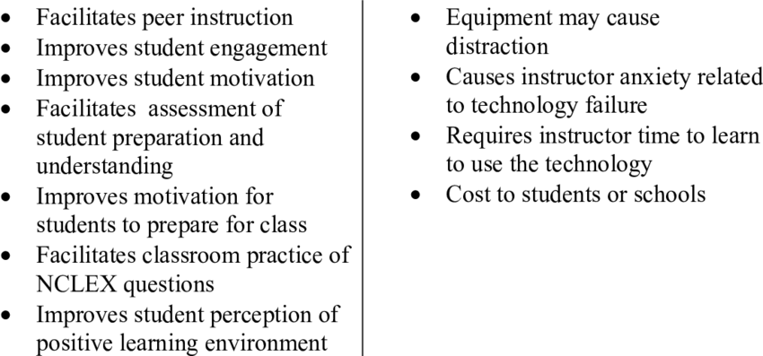
ADVANTAGE LIMITATIONS

Slide 10
Overview of The Project

Slide 11
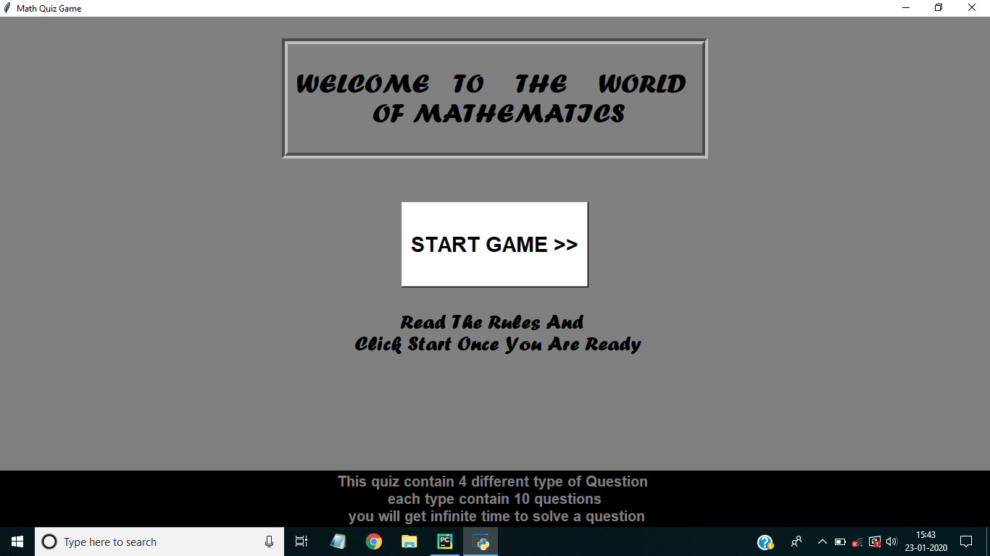
Splash Screen

Slide 12
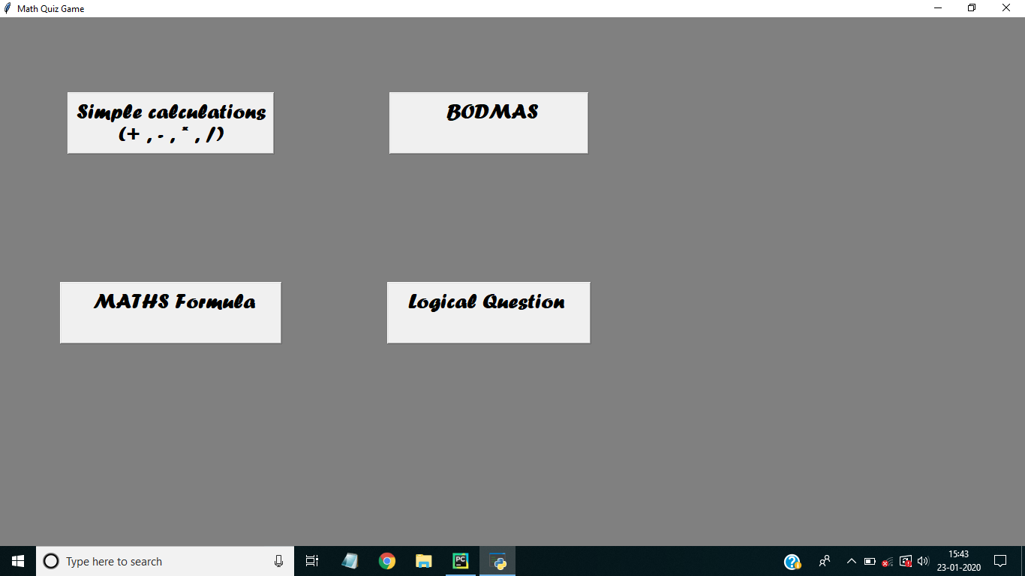
Main Activity

Slide 13
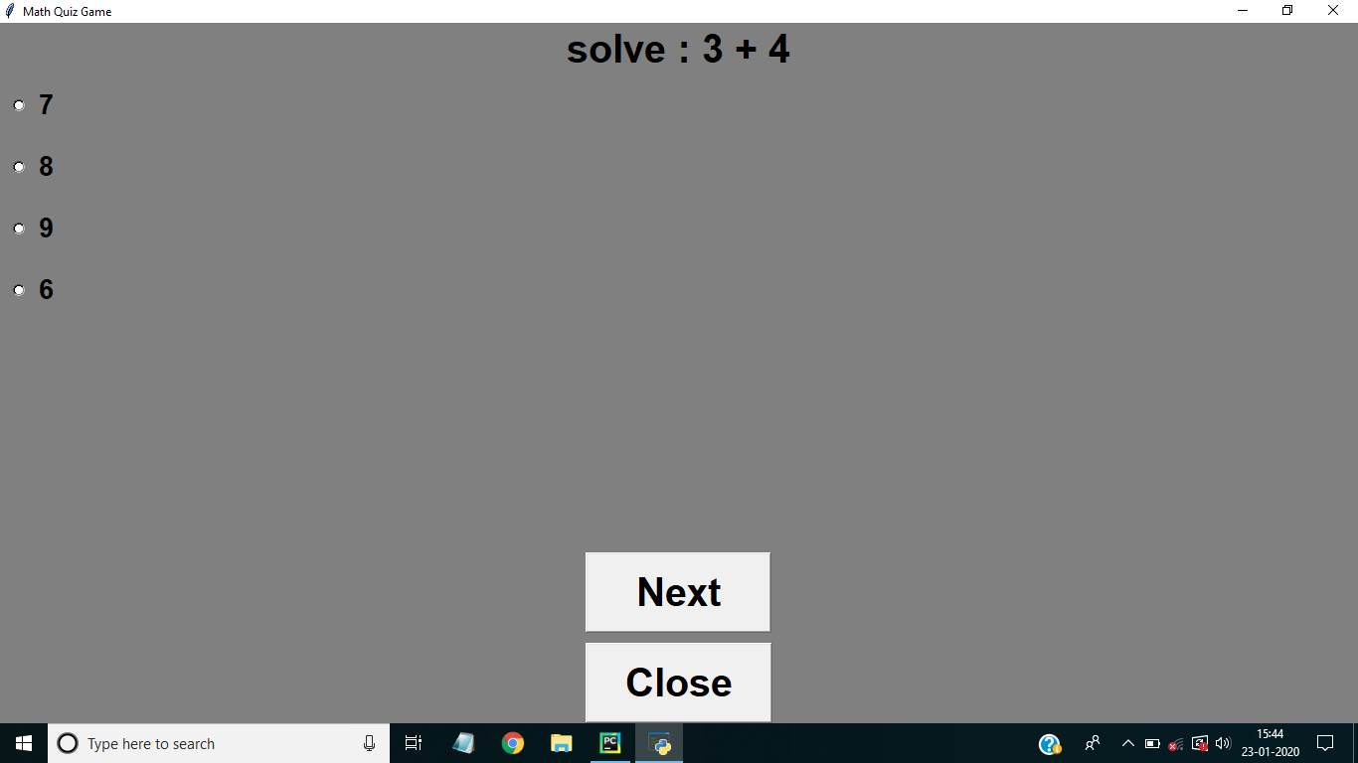
Simple Calculation

Slide 14

Math’s Formula

Slide 15
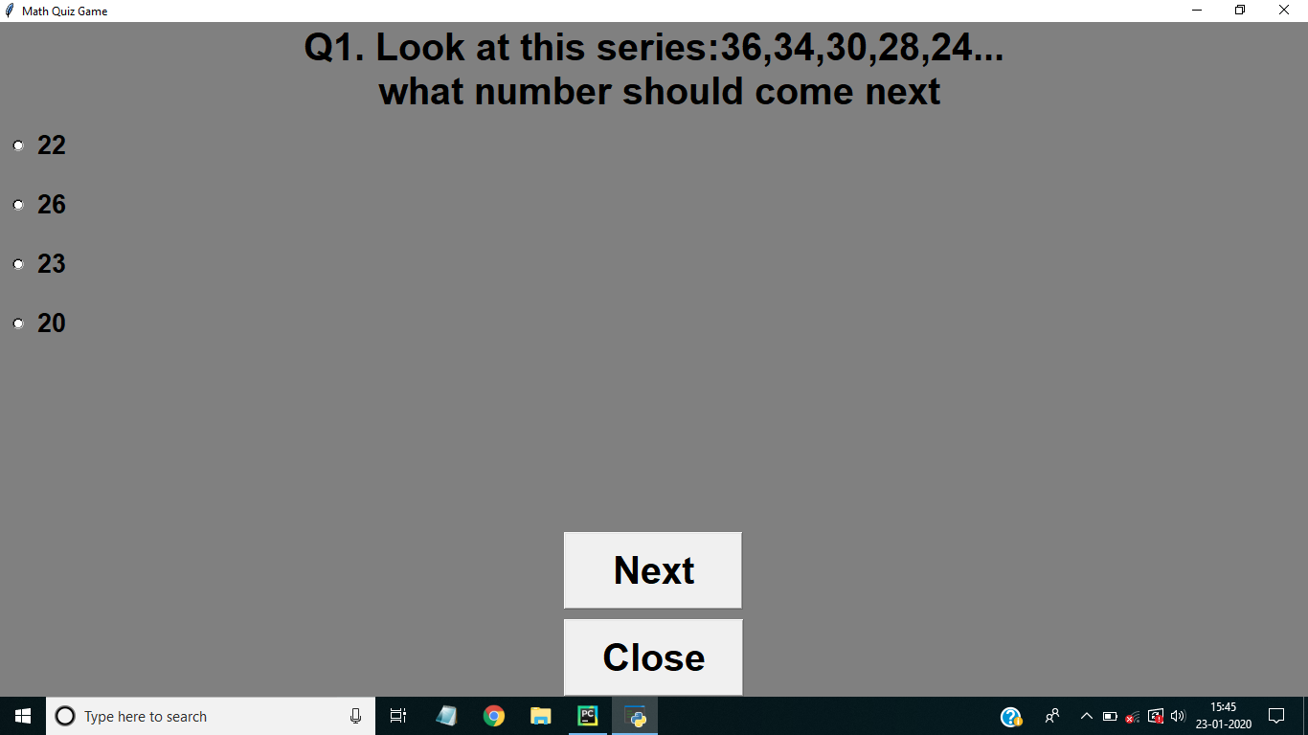
Logical Questions

Slide 16

BODMAS

Slide 17
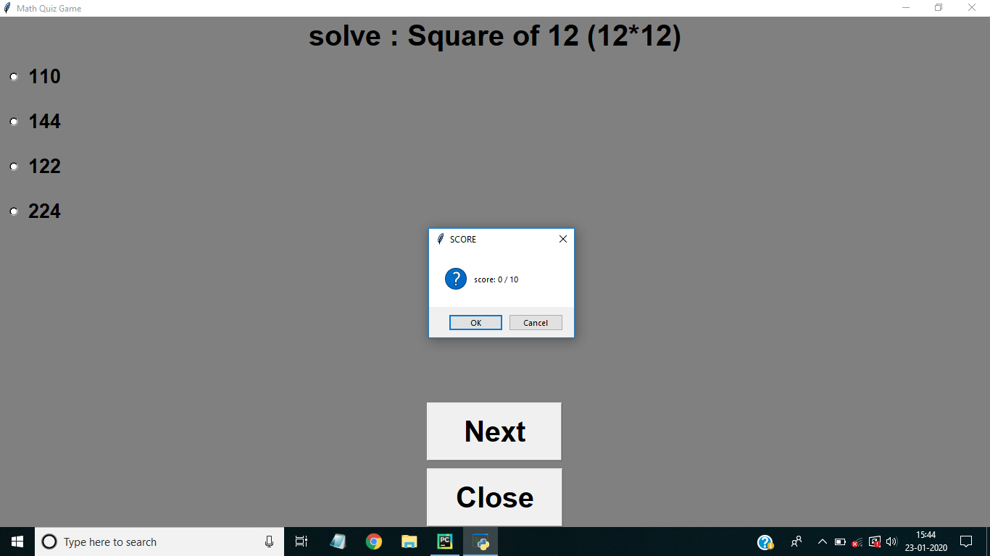
Score Screen

Slide 18
Thanks for watching

